Slide 1

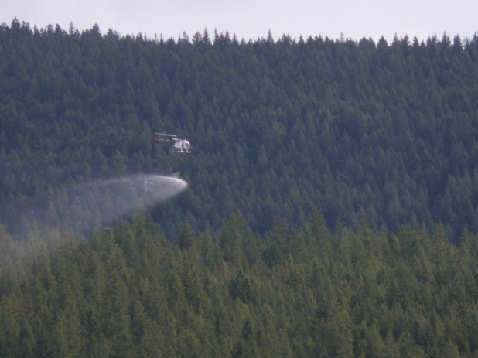

Aerial Fertilization –Operational Considerations
Aerial Fertilization
Operational Considerations

Slide 2
Aerial Fertilization –Operational Considerations
Aerial Fertilization
Introduction
Before embarking on an aerial fertilization project, there are several steps that one must consider.
Stand Suitability- This includes: species composition, age, site index, and crown closure.
Return on investment- Target is >5%, but must be at least greater than 2%
Project Size - usually, the larger the area to treat, the lower the application costs per hectare.

Slide 3
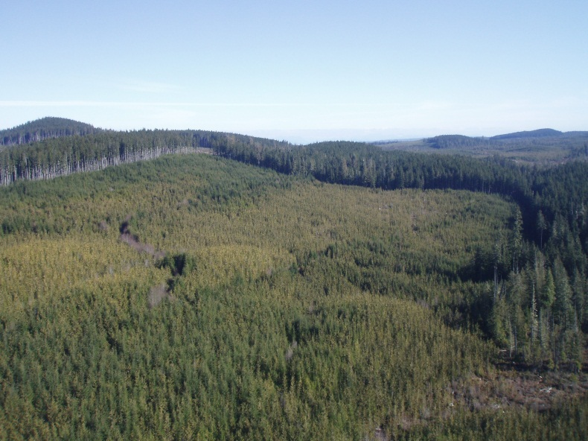
Aerial Fertilization –Operational Considerations
Stand Selection
Most of the initial work is done in the office, using complex GIS queries that identify stands that meet funding criteria. Potential stands must be free of constraints. They cannot be located in areas, such as:
Community Watersheds
Planned Harvesting Blocks
OGMA’s
UWR’s
WHA’s
Private Land
Research Installations
Permanent Sample Plots
Etc…

Slide 4
Aerial Fertilization –Operational Considerations
Operational Considerations
Once you have identified potential stands in the office, it is time verify your findings in the field. Will it be operationally viable?
Before you start confirming stand data in the field, it is best to ensure that you first have:
Good access (for the fertilizer delivery trucks)
Nearby, safe staging, so that you can transfer the fertilizer from the transportation trucks into the helicopter spreading bucket.
This presentation will examine the operational factors that you should consider.

Slide 5
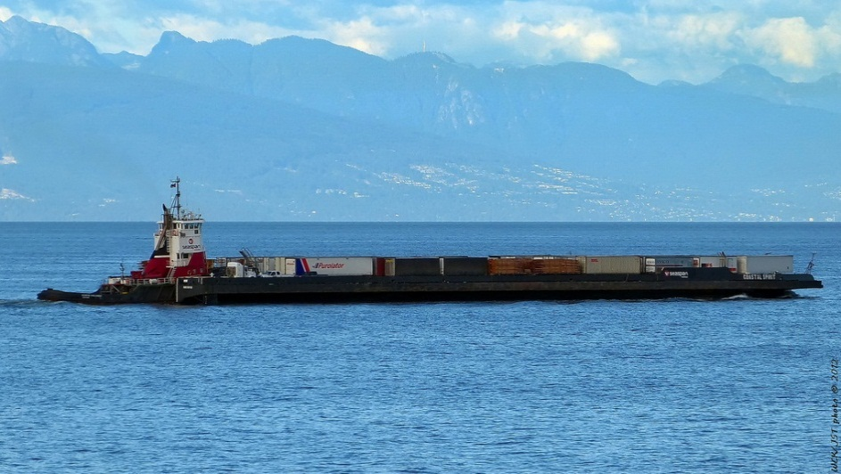
Aerial Fertilization –Operational Considerations
Fertilizer Transportation
Fertilizer comes from the prairies (or California) via rail car. Each rail car carries ~75 000 - 92 000 kgs. Because the rail cars are subject to the railroad’s unpredictable schedules, deliveries have historically been unreliable or delayed.
The delays are often compounded by the fact that railcars need to cross the Straits from Vancouver to the Nanaimo rail yard (Wellcox Yard) on a barge.

Slide 6
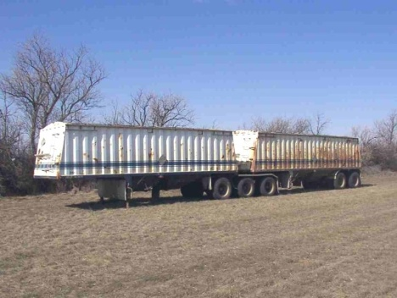
Aerial Fertilization –Operational Considerations
Fertilizer Transportation
Once there, the fertilizer has to be transferred onto trucks called Super B trains. Aerial fertilization applicators usually hire sub-contractors to move fertilizer up and down Island from the rail yard.
NOTE: Each rail car content (fertilizer) is initially weighed at the rail yard.
Super B-trains can carry 42 000 – 45 000 kgs (Approximately half of a rail car) Content is weighed again at DOT scales once transferred onto the Super B-Trains

Slide 7
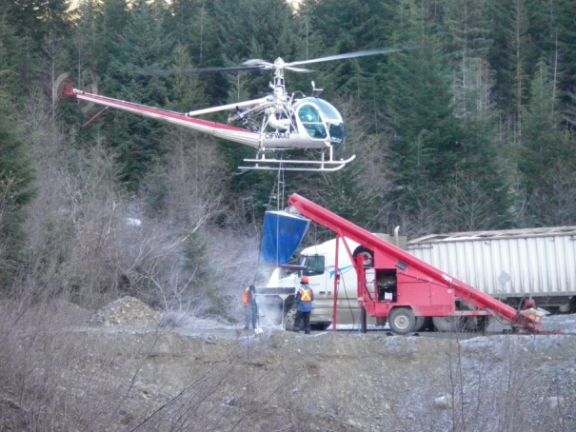
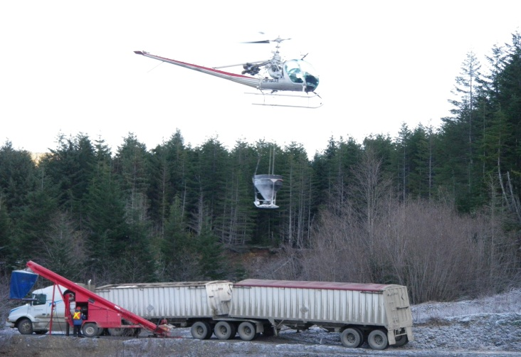
Aerial Fertilization –Operational Considerations
Fertilizer Delivery
Once B-Train has been moved as close as possible to the prescription site, the helicopter can move the fertilizer in one of two ways :
Fertilizer can be transferred directly from Super B Train into the helicopter bucket via auger & bag system. This usually happens when the staging site consists of large, flat, & un-obstructed area.

Slide 8
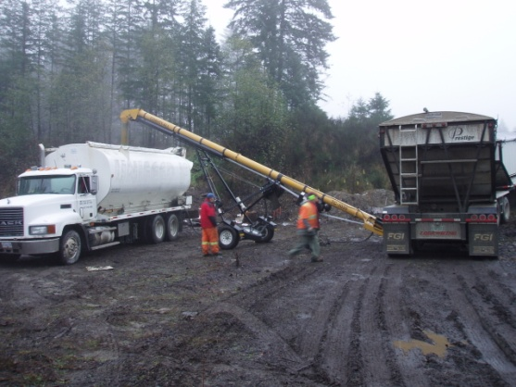
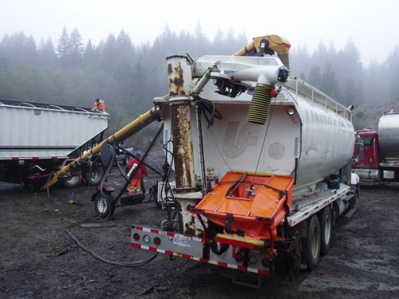
Aerial Fertilization –Operational Considerations
Fertilizer Transfer
Fertilizer can also be transferred from the Super B Train into smaller Grain trucks.

Slide 9
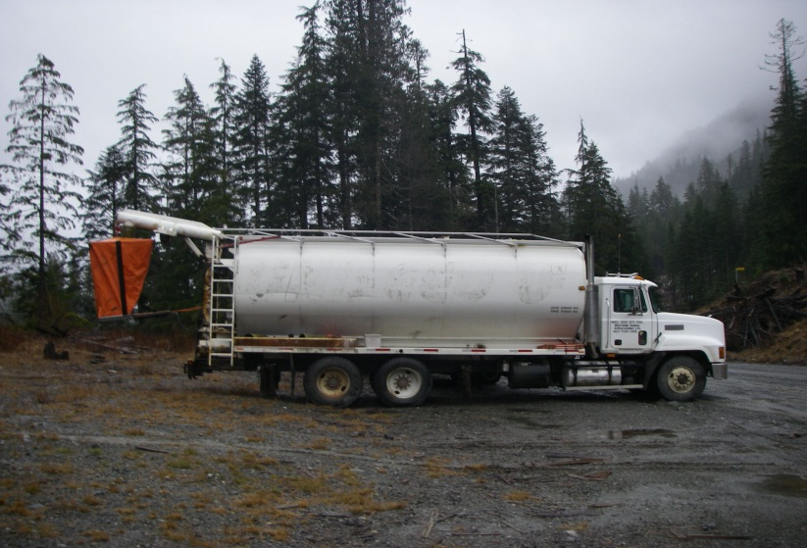
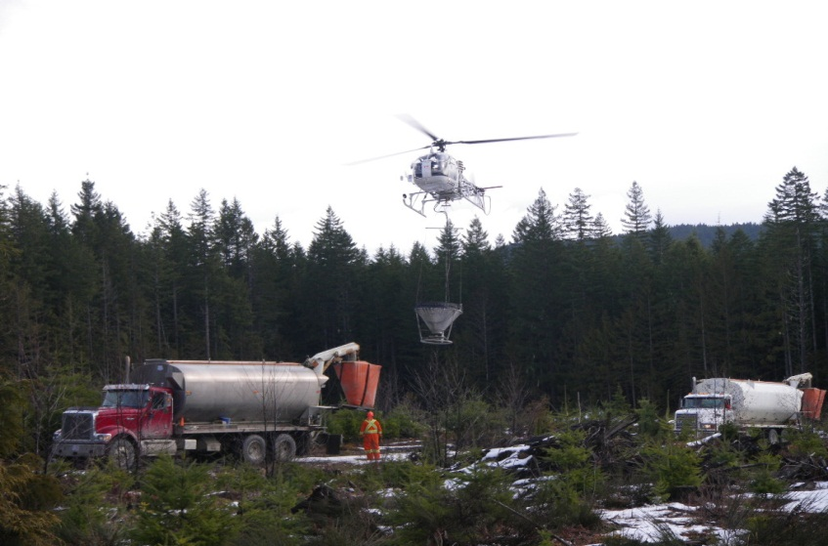
Aerial Fertilization –Operational Considerations
Fertilizer Delivery
Grain Trucks are self contained units, (with own attached auger) that can stage from much smaller openings and require much less set-up time. These units usually only require one operator/ truck driver

Slide 10
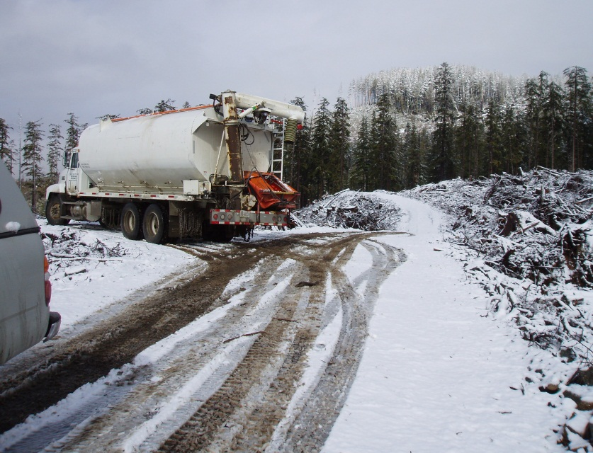
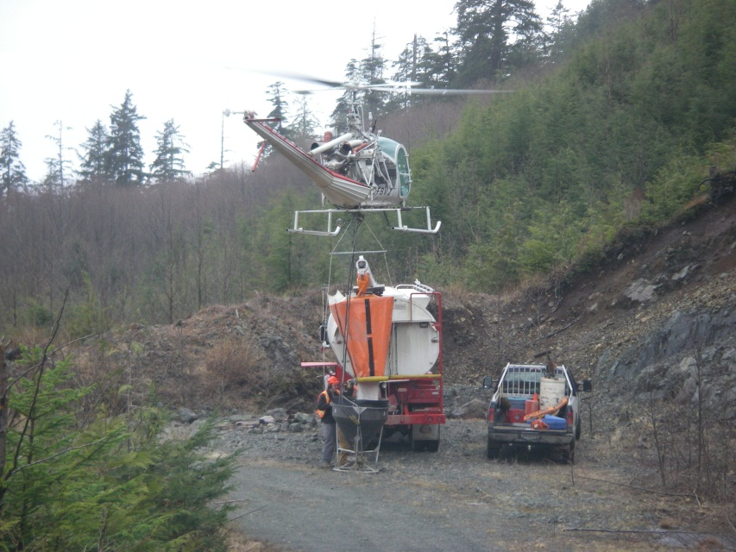
Aerial Fertilization –Operational Considerations
Fertilizer Delivery
Grain Trucks can access hard to reach staging sites where steep grades or road conditions may limit B-Train access. Example: small pull-outs or flat switch backs.

Slide 11
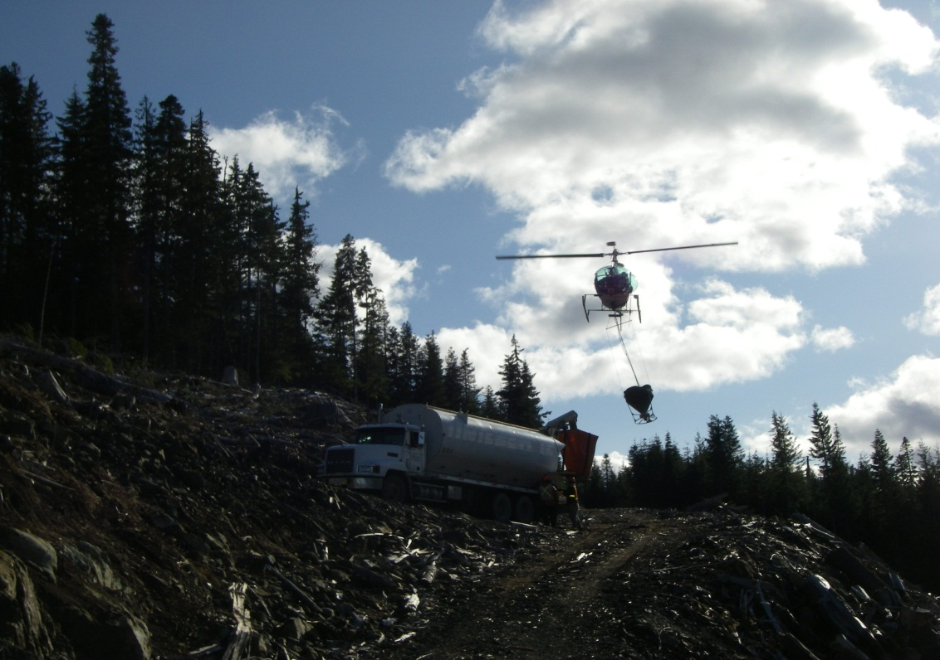
Aerial Fertilization –Operational Considerations
Staging Considerations
Best staging sites: are located above treatment areas, so that the helicopter can fly downhill loaded (requires less energy & fuel) and uphill to reload.
For example: stage off a pull-out or from a landing in a new opening with a drop off below the road.

Slide 12
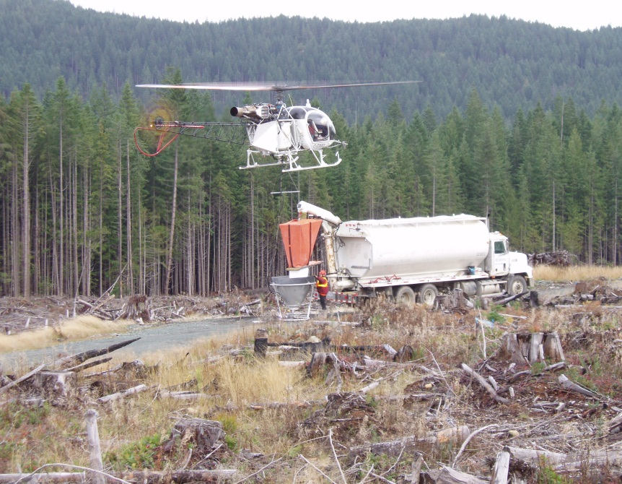
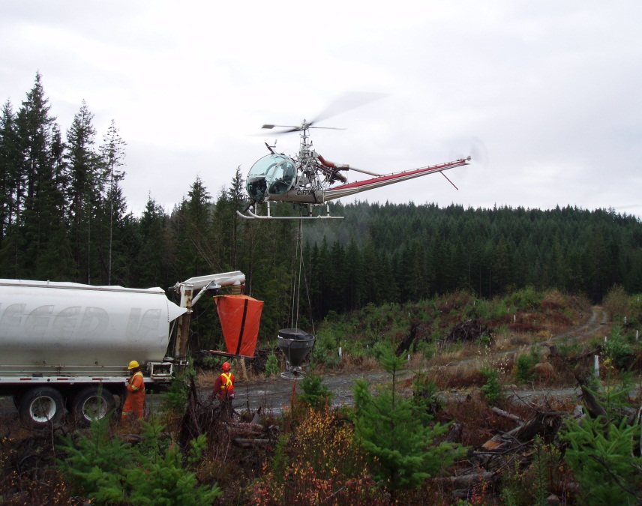
Aerial Fertilization –Operational Considerations
Staging Considerations
Other good staging options also include:
New cut blocks (easy approach & take off)
Large pits or quarries with young & short adjacent timber
Large road junctions (may require traffic control)
Wide, inactive Mainlines (helicopter can fly up and down road)

Slide 13
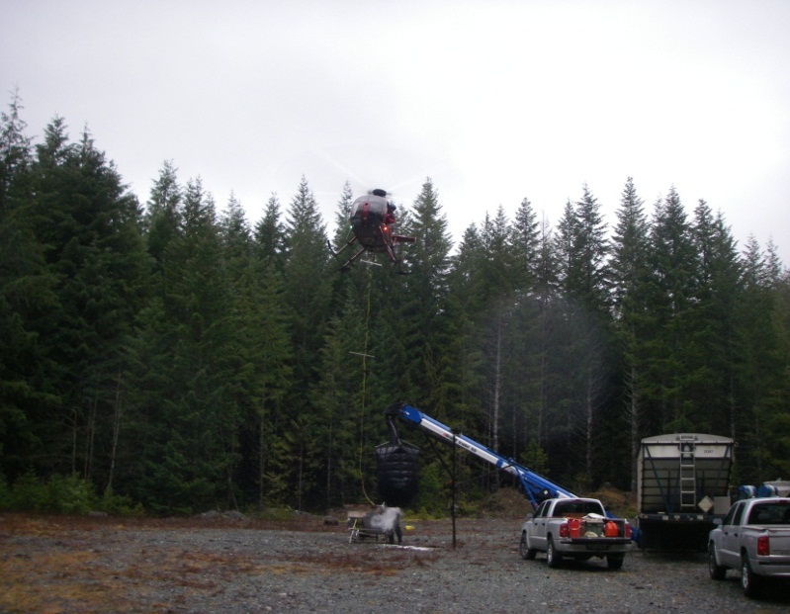
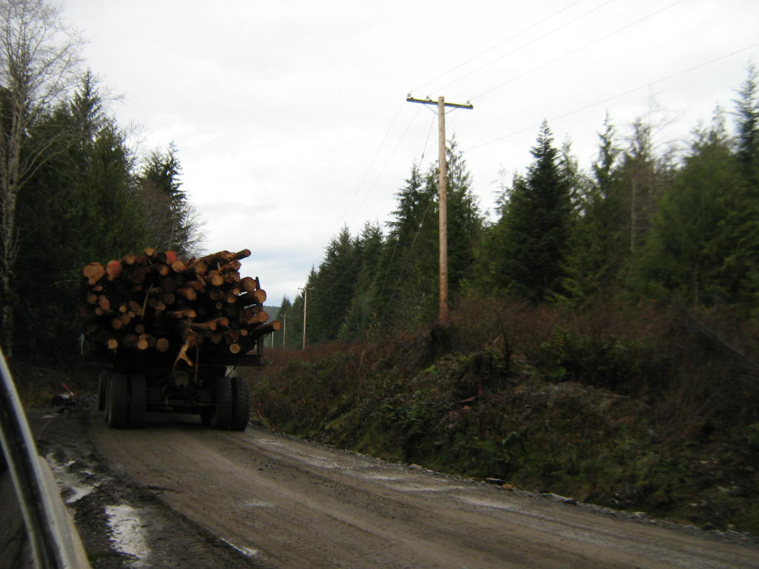
Aerial Fertilization –Operational Considerations
Staging Considerations
Other important staging considerations include:
Avoid staging in small openings with large adjacent timber- Helicopter has to reduce payload or amount of fuel in order to lift vertically out of ‘hole’.
Try to stage within a 2km radius from treatment units. Beyond that, application costs go up rapidly.
Avoid staging near power lines (for obvious safety reasons)

Slide 14
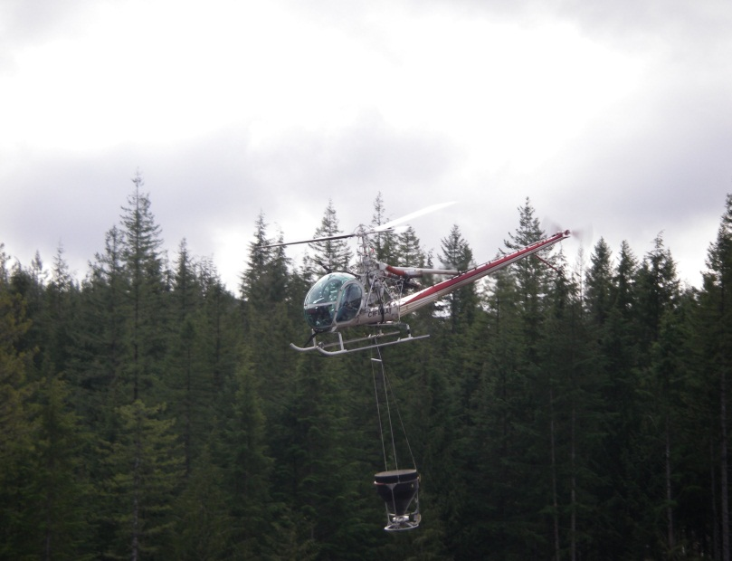
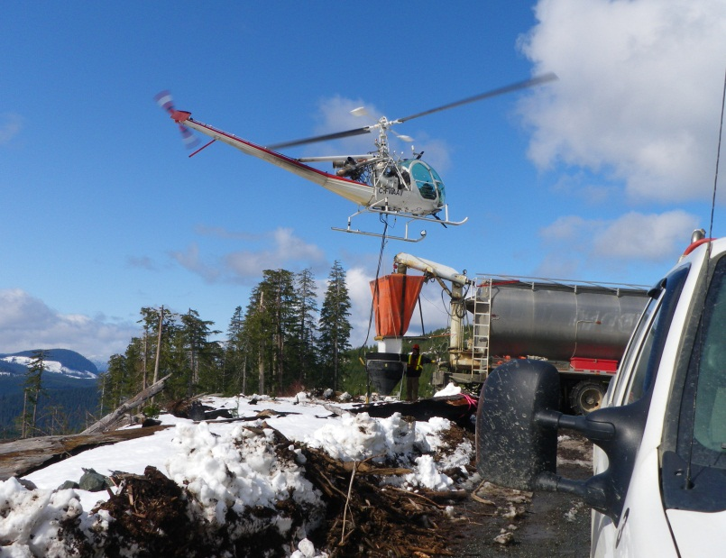
Aerial Fertilization –Operational Considerations
Equipment used
Different helicopters have been used for fertilizer application in the past:
Hiller: A highly maneuverable aircraft that can take 300-350kgs / turn. This helicopter can treat approximately 70-100ha/day

Slide 15
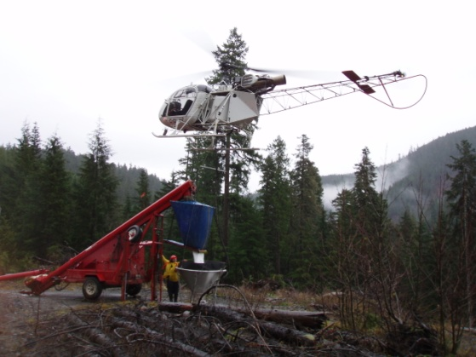
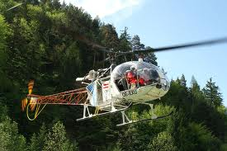
Aerial Fertilization –Operational Considerations
Equipment used
Lama: This is a ‘stripped down’ version of an Aerospatiale A-Star that can carry ~500kgs per turn This helicopter is usually used on larger units because of its speed and greater payload. A Lama can treat in excess of 200ha per day, if ground crew can keep up with fertilizer deliveries.

Slide 16
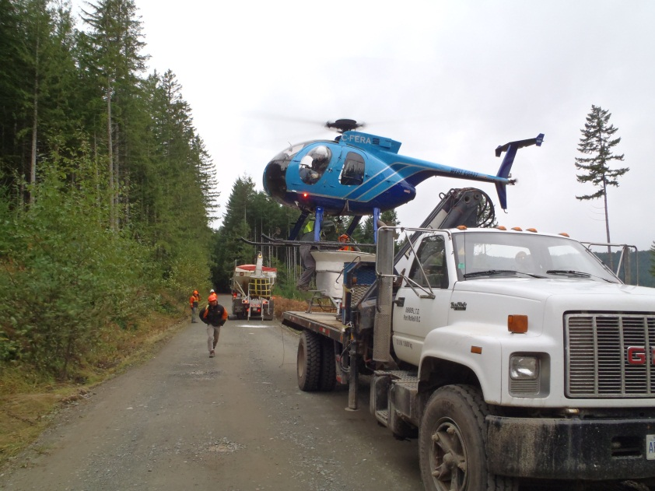
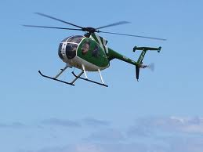
Aerial Fertilization –Operational Considerations
Equipment used
Hughes 500: This aircraft has been popular for fertilizer application because of its ability to move loads out of tight spots or poorer staging areas. It can typically pull ~200-330 kgs per turn. Average production over the last 2 years has been 45-80ha per day.

Slide 17
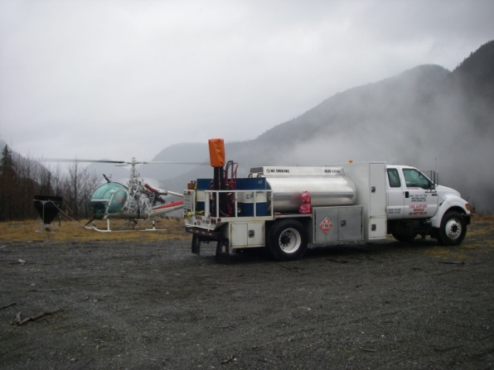
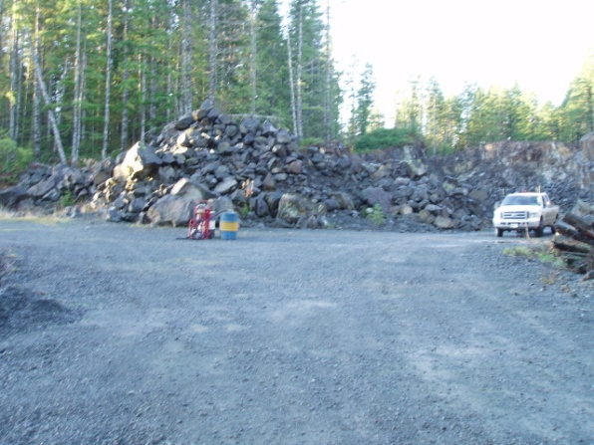
Aerial Fertilization –Operational Considerations
Equipment used
Most operations usually include a refueling truck.
Refueling site requires a cleared landing area away from any water source (usually quarries or gravel pits will work well). It is not necessarily located at the staging site, but it helps if it can be close to the treatment polygons.

Slide 18
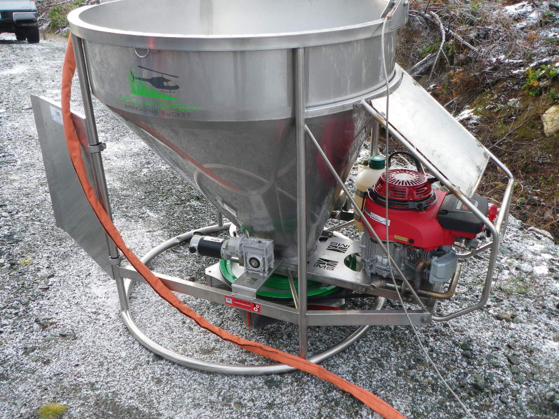
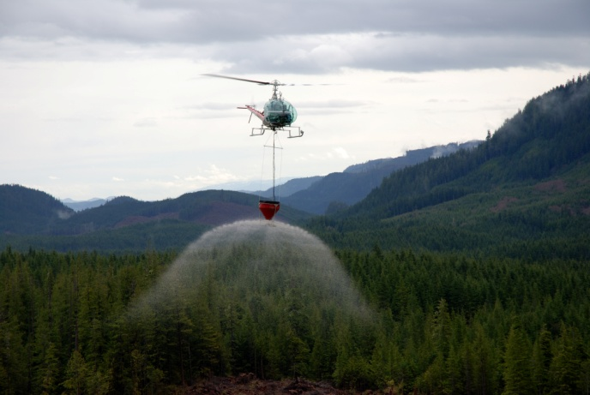
Aerial Fertilization –Operational Considerations
Application swaths
Application swaths are usually between 30-50m wide, depending on the helicopter and bucket used. Effective swath (where most of the fertilizer falls) is slightly narrower (25-40m). ½ a swath overlap is used to ensure complete coverage.
Hiller Application

Slide 19
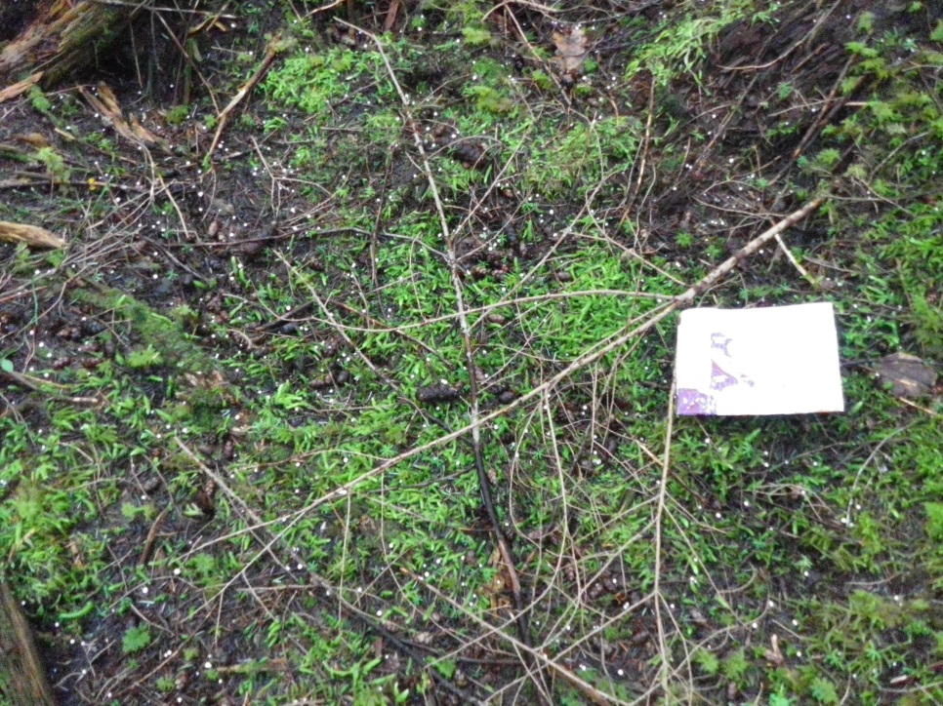
Aerial Fertilization –Operational Considerations
FERTILIZER TYPES:
UREA:
Consists of 46% Nitrogen (46-0-0). Historically, it has been applied on mature Fdc stands and second/ third applications of younger Cw stands. (in salal phase) It is applied at a rate of 200 kgs of Nitrogen/ha or ~435 kgs of urea / ha.

Slide 20
Aerial Fertilization –Operational Considerations
FERTILIZER TYPES:
SCHIRP Blend:
(SCHIRP= Salal Cedar Hemlock Integrated Research Program)
It consists of a pre-mixed blend of Nitrogen (30.5%) and Phosphorous (23%) and is applied at a rate of 740kgs / ha. Research shows that the addition of Phosphorous helps enhance the long term absorption of Nitrogen, especially by Hw.
This type of application has been historically done on younger Cw(Hw) plantations in the North Island. It is usually used on CH (01s) sites where salal competes with conifers for nutrients.
Because it requires more fertilizer, this type of application is more expensive: higher fertilizer costs and higher application costs.

Slide 21
Aerial Fertilization –Operational Considerations
FERTILIZER COSTS:
Helicopter application costs for 2012 should be ~$0.32 to $0.38 per kg
That would be the same cost per kg for Urea or SCHIRP - For Urea, applied at 435 kg/ha that will translate into a cost of $140/ha to $165/ha (we should not see prices below $0.32/kg unless fuel significantly drops in price). For SCHIRP, applied at 740 kg/ha, that would range from $235/ha to $280/ha.
Price of Urea to Vancouver Island this year is $660/ton or ~$287/ha
(last year was $600/ton) .
So, all found costs for Urea application would be: $425- $450 /ha.
At print time, I do not have a price for Schirp blend. We have not applied it in over two years and this year’s program will only include Urea.

Slide 22
Aerial Fertilization –Operational Considerations
USEFUL AERIAL FERTILIZATION INFO:
1 Super B-Train of Urea (42 000-45 000kgs) can usually treat ~100 hectares. (This is ~1/2 a railcar)
The same B-Train with Schirp blend will only treat 55-60 hectares
You can usually empty a Super B Train with 3 grain trucks.
Ideal distance from staging site to treatment unit should be less than 2kms (the closer the better). Applicators will often relocated trucks several times to reduce flight distances.
Best staging sites are above treatment areas: Easier to fly loaded downhill than uphill.

Slide 23
Aerial Fertilization –Operational Considerations
MANUAL FERTILIZATION
Good solution for late rotation stands where there is good mobility.
Access, mobility (terrain, brush) and proportion of stems to fertilize are the most important variables.
~0.5 kg per tree
Use planting bags and a scoop, apply with back to the tree, turning around the tree and tossing fertilizer as consistently as possible to the edge of the drip line
Treat 20 cm + dbh dominants & co-dominants with good crown form or about 350 stems/ha .
150 meters walking distance to the backend is usually the maximum distance from vehicle (truck/quad )access. In other words: you need good access to move fertilizer bags and easy walking for crew. Stands with thick underbrush are out!
Longer walks are possible but will impair productivity. The above scenario should result in production of 1.5 ha per man day.

Slide 24
Aerial Fertilization –Operational Considerations
MANUAL FERTILIZATION
Some advantages of manual fertilization over aerial programs:
Greater control of where the fertilizer is applied (select best trees and desired species)
Can easily avoid small creeks, NP areas
Can avoid non-target species, trees with poor stem form or poor canopy position
Weather is much less of a controlling factor (can work in fog!)
Small areas are economically treated
Employment / relationships with smaller communities (Islands, First Nations)

Slide 25
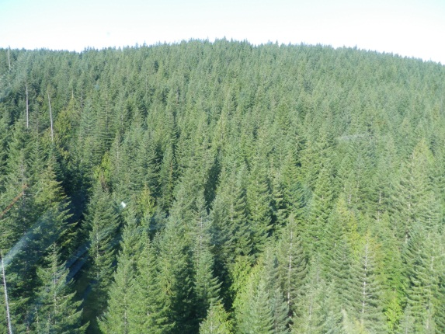
Aerial Fertilization –Operational Considerations
Acknowledgements
I would like to thank the following individuals for sharing their valuable knowledge with me over the past few years of fertilization:
Annette Van Niejenhuis
Jason Hunter & the Western Aerial Application Crew
Trevor Waddell & the West Coast Helicopter Crew
Jeff Sandford
Monty Locke
Rick Monchak- for the manual fertilization section

